Slide 1

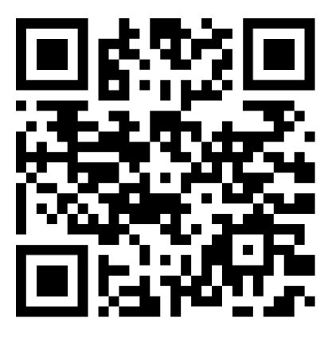
ICCN
Who attends?
880 – 1100 Attendees
Why?
More than 50 Symposia sessions
15 Teaching Courses- Workshops
321 Posters Presented
Visit the Sponsors & Exhibitors
Learn more

Slide 2

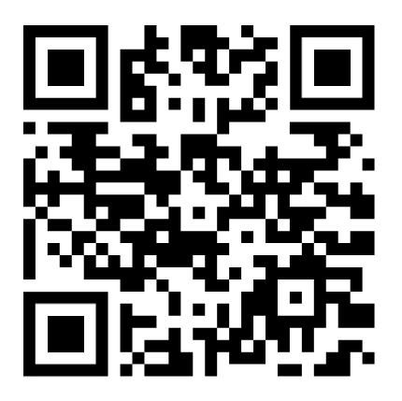
ICCN 2026 Programme Overview
Tuesday Sept 8, 2026 Wednesday Sept 9, 2026
8:00am – 5:00pm Pre-Congress Workshops 8:00am – 5:00pm Pre-Congress Workshops
Thursday Sept 10, 2026 Friday Sept 11, 2026
8:00am Opening Ceremony/ Mark Hallett Plenary Lecture 8:00am – 5:00pm Symposia Sessions
9:00am – 5:00pm Symposia Sessions 1:30 – 2:15pm Jasper Plenary Lecture
5:00pm Presidential Lecture 11:00am IFCN General Assembly
6:00–7:00pm Welcome Reception 4:30 – 5:15pm Kugelberg Plenary Lecture
6:30 – 11:30pm Gala Dinner (separate location)
Saturday Sept 12, 2026
9:00am – 12:00pm Symposia Sessions
1:00pm Awards and Closing Ceremony
Register Today!

Slide 3


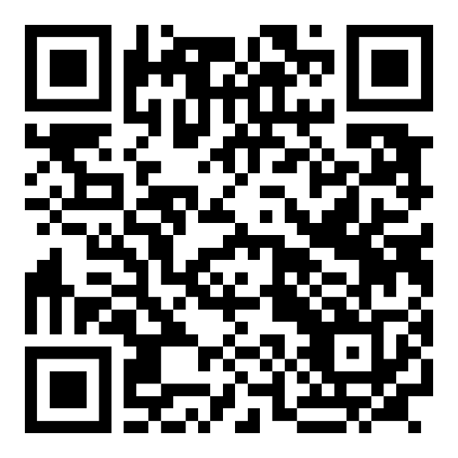
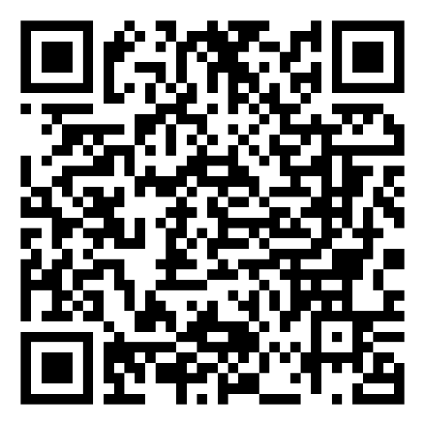
IFCN Journals

